Slide 1


V. T. Patel Department of
Electronics and Communication Engineering
EC249 MINI PROJECT-II
Object Detector Using Arduino
With GUI & App
MADE BY:
Amartya Singh(17EC088)
17ec088@charusat.edu.in
UNDER GUIDANCE OF:
VISHAL TANK
vishaltank.ec@charusat.edu.in

Slide 2
Let’s Go With The Flow
Introduction
Block Diagram
Circuit Diagram
Applications

Slide 3
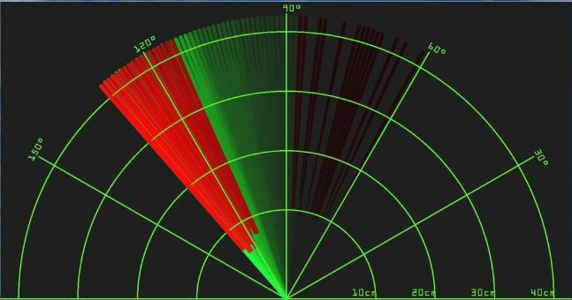
INTRODUCTION
This can detect the object which will enter in the deployed area of the sensor
It can work both in day & night as it uses ultrasonic waves to detect object
It can only tell the direction from where the object is approaching
It will work in the similar manner of SONAR
It can scan the area of 180 degree at a time
A servo motor will be connected to the ultrasonic sensor which will control it’s movement
A Bluetooth module is there to transfer data wirelessly to the mobile application
A user friendly GRAPH based GUI will be there on both PC and mobile to use this system

Slide 4

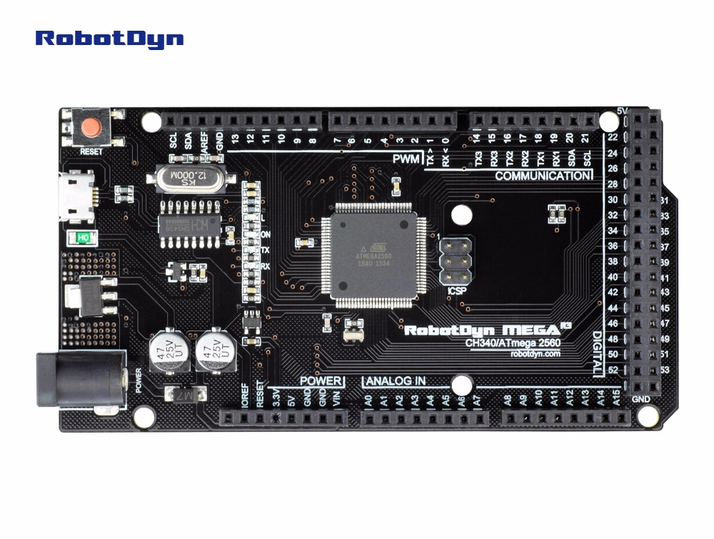
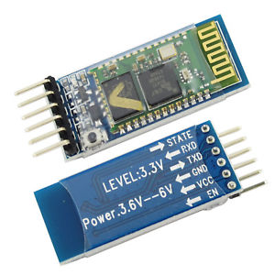
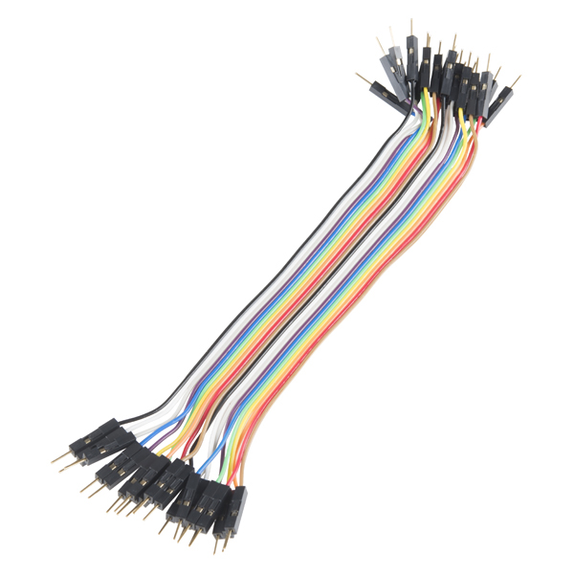
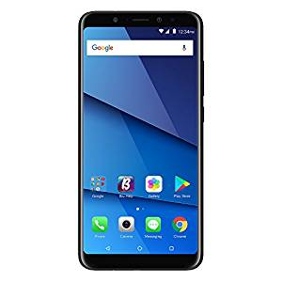

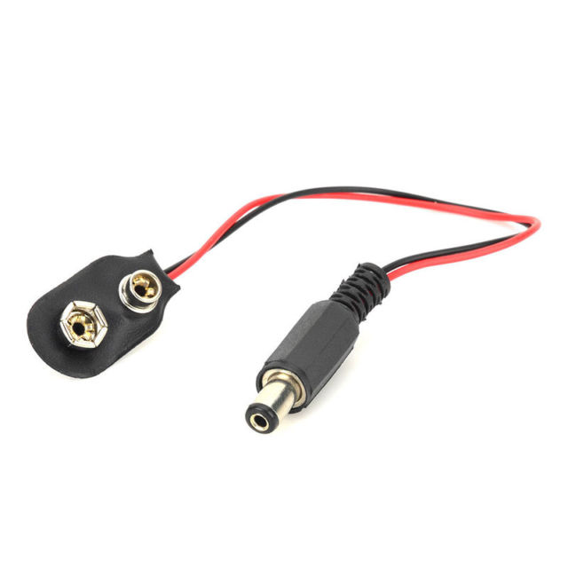
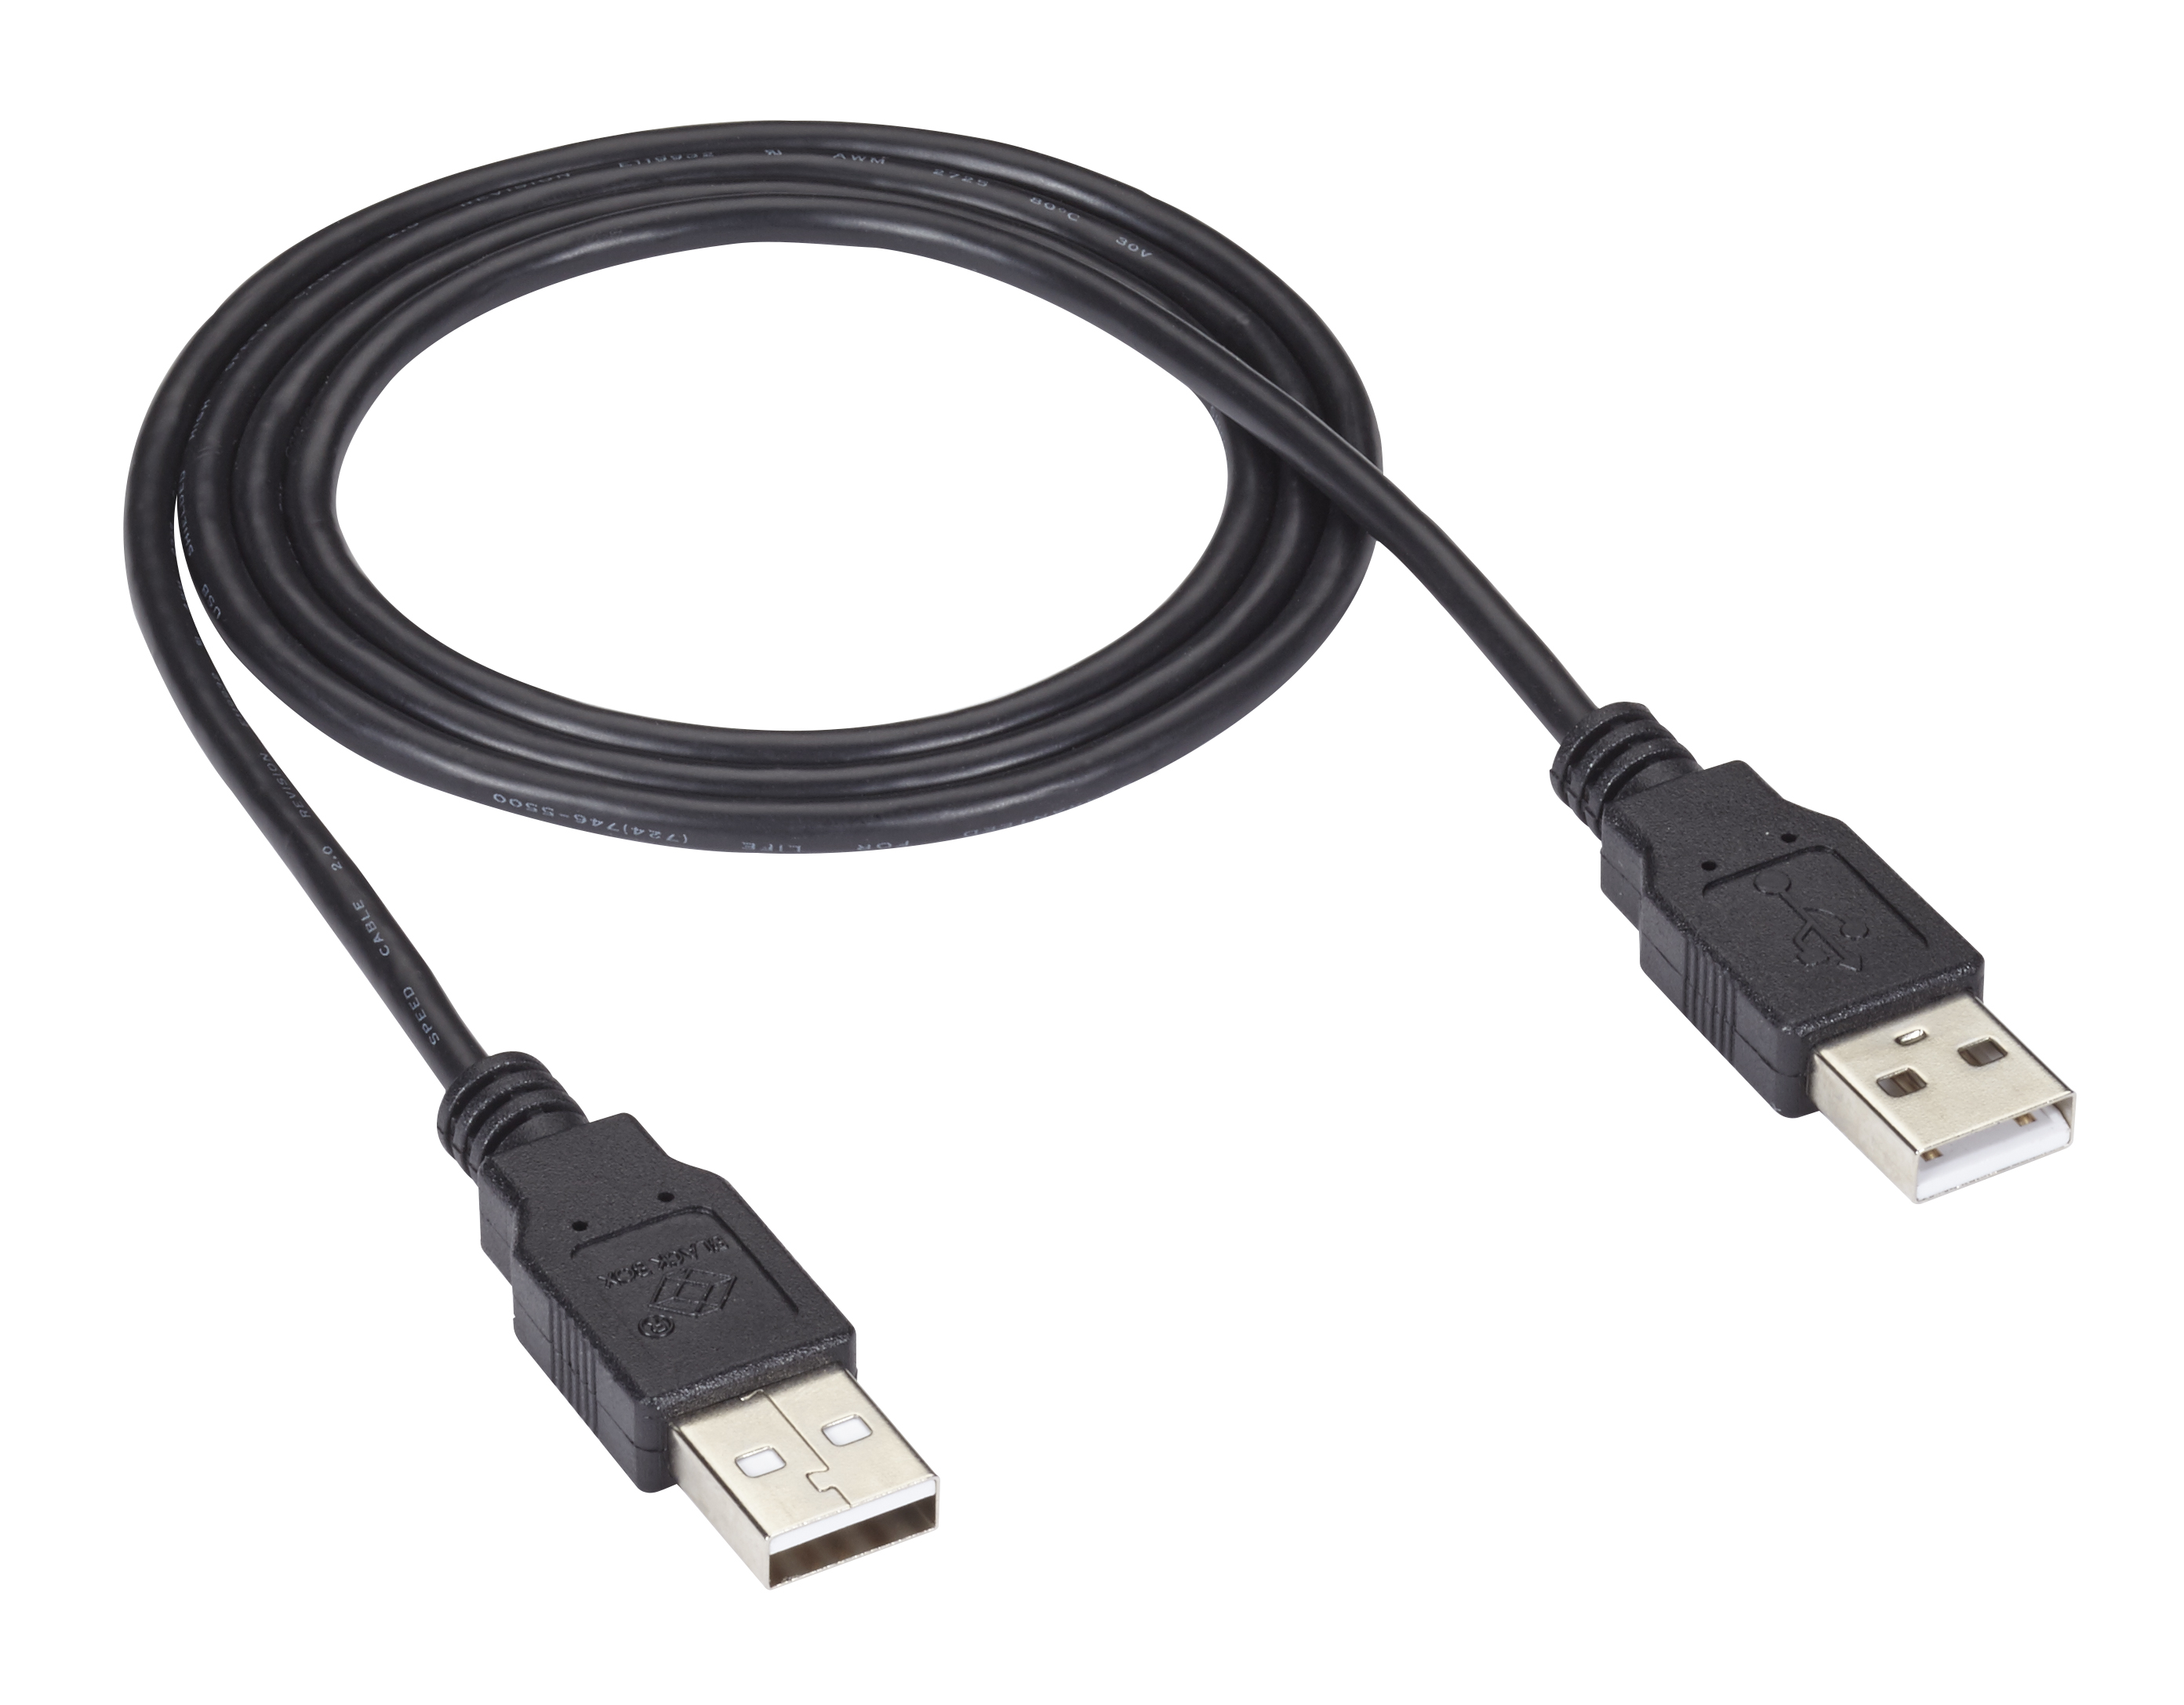

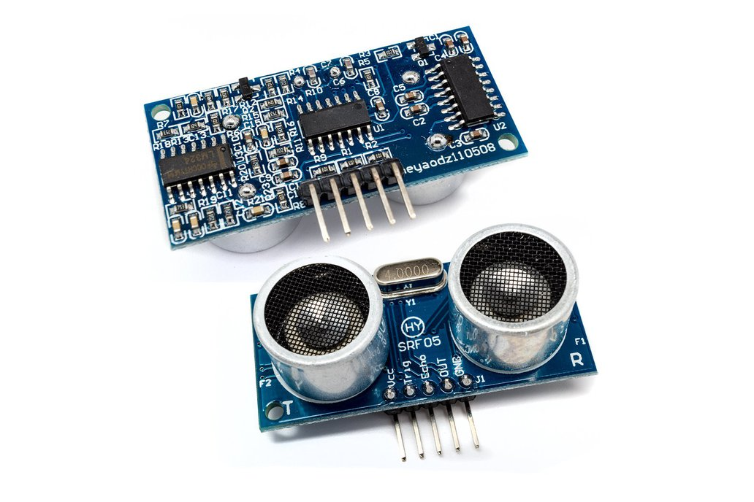
Components Used
SG 90
Servo Motor
ARDUINO MEGA 2560
HC 05
Bluetooth Module
Power Jack
HC SR 05
Ultrasonic Sensor

Slide 5






Software To Be Used
IDEs
SDK
Programming Language
Dart
C
VS Code
Flutter
Java
Arduino IDE

Slide 6
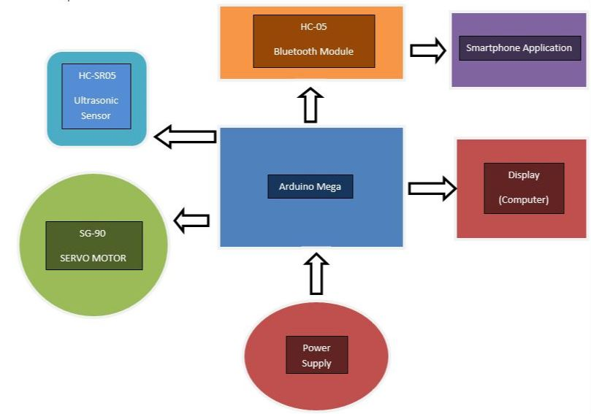
BLOCK Diagram

Slide 7
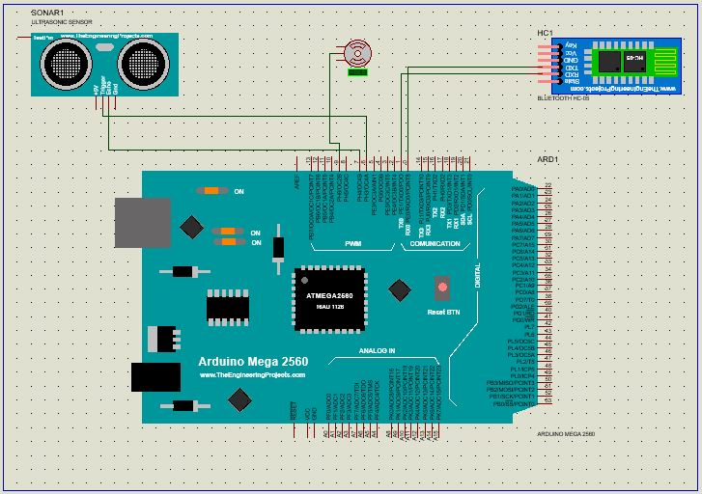
CIRCUIT DIAGRAM

Slide 8
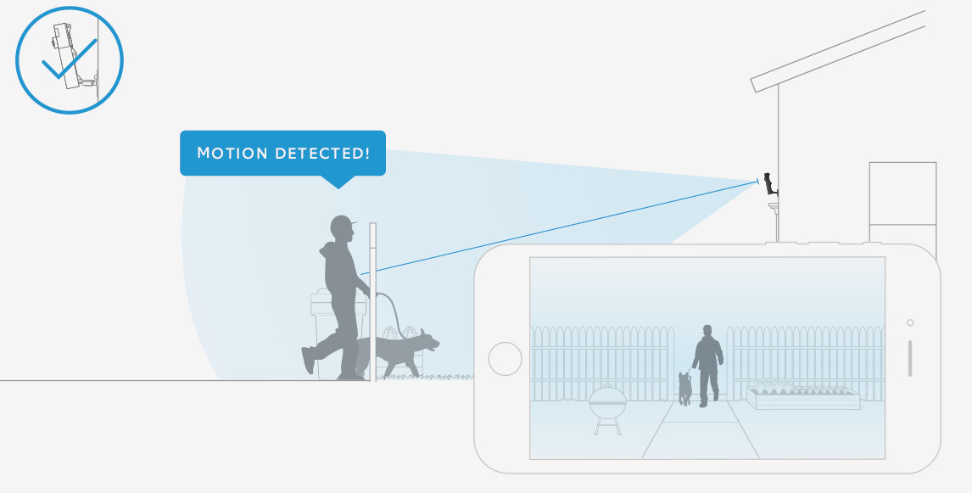




Applications
Defence Weaponry
Security Purpose
Parking System
Automated Driving

Slide 9
References
Arduino Website: https://www.arduino.cc/
Ultrasonic Sensor Setup in Proteus: http://www.theengineeringprojects.com/2015/02/ultrasonic-sensor-library-proteus.html
Bluetooth Module Setup in Proteus: http://www.theengineeringprojects.com/2016/03/bluetooth-library-for-proteus.html
About HC 05: https://wiki.eprolabs.com/index.php?title=Bluetooth_Module_HC-05
About HC SR 05: https://wiki.eprolabs.com/index.php?title=Ultrasonic_Sensor_SRF-05
About SG 90: https://wiki.eprolabs.com/index.php?title=Micro_Servo_motor_SG90
About Arduino Mega: https://wiki.eprolabs.com/index.php?title=Arduino_Mega_2560
Idea Taken from : https://maker.pro/arduino/projects/how-to-build-an-object-detector-with-arduino-using-an-hc-sr04-and-an-sg90-servo#project-details

